Slide 1

REAL LIFE LAB
GROUP 1
FIRSTCRY

Slide 2

TEAM MEMBERS
Bhumika B S
Satya Ranjan Acharya.
Arun Prasaanth Bakthavachalam.
C V Vishnupriya.
Swapnanil Guchhait.
Guntikala Samyuktha Rani.
Bhoomika C Shetty
Akash.J
Valathuru Yamini.

Slide 3
CONTENTS
Objective.
Introduction.
Scenario Module
Technology
Background of the Project.
Feature Files
Read Excel.
ITestListeners
Extent Reports

Slide 4

OBJECTIVE
To create a test script to automate the test scenario and generate the reports for firstcry.com website.

Slide 5
INTRODUCTION
FirstCry is India’s largest online shop for new mom and baby products, offering top of the line discounts on renowned national & International brands.
It is a single, convenient and comprehensive platform for parents that can help them make well researched and informed choices for products they need for their kid.
FirstCry giving a choice of more than 100000 products across 1000+ top International and Indian brands like Mattel, Ben10, Pigeon, Funskool, Hotwheels, Nuby, Farlin, Medela, Pampers, Disney, Barbie, Gerber, Fisher Price, Mee Mee and more.
FirstCry aims to provide best of the products/brands at the best prices with a great online shopping experience, fast and reliable delivery service and a prompt customer care.

Slide 6
SCENARIO MODULES
Navigate to the URL, Enter the Credentials , and click on the login.
Navigate to the URL, login into the application. Click on the Home > My Account > My Profile. Perform the Edit Operation.
Navigate to the URL, login into the application. Search for any product.
Navigate to the URL, login into the application. Search for any product from the search result to the cart.
Navigate to the URL, login into the application. Click on the Stores & Preschools >> Find Store.
Navigate to the URL, login into the application. Click on the Stores & Preschools >> Find Preschool Locator.
Navigate to the URL, login into the application. Click on the cart after adding products, Perform all operations in cart
Navigate to the URL, login into the application. Click on the shortlist after shortlisting few product. Perform all operation in Shortlist.

Slide 7
TECHNOLOGY
1.Selenium: Selenium is an open-source framework used for automating web browsers. It provides a set of tools and libraries that allow testers to interact with web elements, perform actions, and verify expected results. Selenium supports various programming languages like Java, Python, C#, and more.
2. Listeners: Listeners are basically the ones who have the ability to listen to a particular event. It is defined as an interface that modifies the behavior of the system. Listeners allow customization of reports and logs.
Listeners mainly comprise of two types, namely
WebDriver listeners: WebDriver listeners in Selenium are event listeners that allow you to listen to events emitted by the WebDriver. Consequently, these listeners provide an extra layer of functionality. This allows you to capture and process events, such as navigating to a new URL or clicking on an element.
TestNG listeners:TestNG listeners in Selenium to perform operations before and after we execute a test method. We can provide additional functionality to TestNG tests, such as capturing screenshots or logging test results.

Slide 8
TECHNOLOGY
3.Cucumber: Cucumber is a tool that follows the behavior-driven development (BDD) approach for software testing. It allows testers to write executable specifications in a readable format called Gherkin.
Gherkin uses a set of special keywords to give structure and meaning to executable specifications. Each keyword is translated to many spoken languages; in this reference we’ll use English.
Most lines in a Gherkin document start with one of the keywords. Each step starts with Given, When, Then, And, or But. Cucumber executes each step in a scenario one at a time, in the sequence you’ve written them in. When Cucumber tries to execute a step, it looks for a matching step definition to execute.
4.TestNG: TestNG is a testing framework for Java-based applications. It provides advanced features and functionalities compared to the traditional JUnit framework. TestNG supports parallel test execution, test configuration through annotations, data-driven testing, and comprehensive test reporting.
These technologies can be used together in a testing framework to automate tests, define test scenarios using BDD principles, and execute tests with advanced features like data-driven testing.

Slide 9
TECHNOLOGY
POM (Page Object Model) :It is a design pattern commonly used in Selenium automation testing to enhance the maintainability and reusability of test code. It helps in separating the test code from the actual web elements and their interactions on the page.
In POM, each web page or component of a web application is represented as a separate class called a "Page Object." The Page Object class encapsulates the elements and methods related to that specific page or component.
Mouse Hover : "hover over" refers to the action of moving the mouse pointer over an element on a web page without clicking it. This action can be used to reveal hidden elements that are associated with the hovered element. To perform a hover over action , we can use the Actions class provided by the Selenium WebDriver. By using the `move_to_element()` method from the Actions class, you can move the mouse pointer to the desired element.
Dropdown :Dropdowns are commonly used in web applications to provide a list of options for users to choose from. Selenium provides several methods to interact with dropdowns and select or retrieve values from them.
Eg: select_by_visible_text() , select_by_value() , select_by_index()

Slide 10
BACKGROUND OF THE PROJECT
Mphasis has developed a new site for e-Commerce website. It provides
the user with different options for e-Commerce website.
Following are functionalities for the site:
1.Login.
2.MyProfile.
3.Search.
4.AddToCart.
5.Store Locator.
6.Preschool Locator.
7.Cart Functionaity.
8.Shortlist.

Slide 11
FEATURE
The feature file serves as a collaboration tool between the business stakeholders, developers, and testers. It helps to bridge the gap between technical and non-technical team members by providing a common language to describe the expected behavior of the software.
The uses of feature files in Cucumber are:
1.Documentation: Feature files act as living documentation that describes the behavior of the software in a language that is understandable by both technical and non-technical team members. They provide a clear understanding of the features being developed and tested.
2. Test Scenario Definition: Feature files define the test scenarios in a structured manner using the Gherkin syntax. Each scenario outlines a specific use case or behavior of the software, making it easier to understand and execute the tests.
.

Slide 12
FEATURE
3. Test Case Generation: Feature files serve as a basis for generating automated test cases. The scenarios and steps defined in the feature files can be mapped to corresponding step definitions in the automation code, allowing the tests to be executed automatically
4. Collaboration and Communication: Feature files promote collaboration among team members. Business stakeholders can provide input and feedback on the scenarios, while developers and testers can ensure that the implementation meets the desired behavior.
5. Behavior-Driven Development (BDD): Feature files are a core component of the BDD approach, where the focus is on defining the desired behavior of the software through collaboration and communication. BDD emphasizes the use of feature files to drive development and testing activities.

Slide 13
LOGIN FEATURE FILE
Feature: FirstCry Login Automation
@Rani
Scenario: Login to FirstCry
Given a user is in the LandingPage on Firstcry
When user click on the login button
And user enter valid emailid
And user click on the continue button
And user click the submit button
And user should be logged in successfully
And user again go to login page
And enter invalid emailid
Then user cant login and screenshot is generated

Slide 14
MY PROFILE FEATURE FILE
Feature: MyProfile Functionality
Scenario: User edits their profile information
Given I open the browser
When I navigate to the application
When I Log in with valid credentials
When I click on My Account
And I select My Profile
And I perform an Edit operation

Slide 15
SEARCH FEATURE FILE
Feature: Test the Search Functionality
@TC_001
Scenario: Verify the search results of Items
Given a user is in LandingPage on Firstcry
When he login
And he search for Watches
Then he must be able to see the Silicone Spiky Sporty Watch item successfully.
@TC_002
Scenario: Verify the search results of Jackets
And he search for Jackets
Then he must be able to see the Kookie Kids Full Sleeves Hoodie item successfully.
@TC_003
Scenario: Verify the search results of Shirts
And he search for Shirts
Then he must be able to see Pine Kids Cotton Roll Up Full Sleeves Check Shirt item successfully.
@TC_004
Scenario: Verify the search results of Pants
And he search for Pants
Then he must be able to see the Babyhug Denim Full Length Stretchable Washed Jogger item successfully.

Slide 16
ADD TO CART FEATURE FILE
Feature: Add To Cart
@TC_101 @Add_To_Cart
Scenario: a user with sees an text message while logging in
Given a user is on the landing page of firstcry
When he type 'Computer Accessories' and select the first option from the auto-complete box
And he click 'Add to Cart' button
Then he must see the text messsage - 'Portronics POR-704 Portable Laptop Stand with Cooling Fan - Grey' is displayed

Slide 17
STORE LOCATOR FEATURE FILE
Feature: Display Search store result
Scenario : A user must be able to see the Find store results
Given A user is on landing page
When he click on Login page and enter the details
And he hover over the stores & Preschools
And he click on Find stores
And he switch focus to new tab
And he select the store Type, state, city and click search button
Then he must able to see the Search store result

Slide 18
PRE SCHOOL LOCATOR FEATURE FILE
Feature: Locate the preschool using location
@TC_101 @find_preschool
Scenario: A user able to find preschool locator
Given A user is on landing page
When he clicks on login
And he entered into login page
And he hovers preschool&stores and click select 'find preschool' in the submenu
And he switches focus to new tab
And he click on the second available city
And click on findmy preschool
Then he must be able to verify the text "FirstCry Intellitots Preschools In Agra"
#Examples:
#|cityname|
#|Bangalore|
#|Chennai|
#|Vijayawada|
#

Slide 19
CART FEATURE FILE
Feature: Cart Functionality
@Cart
Scenario: A user must be able to perform in the Cart
Given a user is in the LandingPage on Firstcry
When he login
And he search for Watches
And he clicks on first result
And he clicks on Add to Cart option
And he clicks on Cart option
And he clicks on quantity
And he clicks on two
And he click on Remove option
Then he must be able to see empty cart

Slide 20
SHORTLIST FEATURE FILE
Feature: Shortlist products in an application
Scenario: Shortlist products
Given I am on the login page
When I log in with valid credentials
And I shortlist a few products
And I click on the Shortlist button
Then the selected products should be in my Shortlist

Slide 21
READ EXCEL
read_excel() function is basically used to import/read an Excel file and it can only be accessed after importing the readxl library in language.
The read_excel() method extracts the data from the Excel file and returns it as an data frame. It instantly recognizes the Excel file’s sheets and imports the data from the default sheet, which is often the first page. The sheet option allows us to give a specific sheet’s name or index in order to read that particular sheet.

Slide 22
READ EXCEL
package utils;
import java.io.File;
import java.io.FileInputStream;
import java.io.IOException;
import org.apache.poi.ss.usermodel.Cell;
import org.apache.poi.ss.usermodel.DataFormatter;
import org.apache.poi.ss.usermodel.Row;
import org.apache.poi.ss.usermodel.Sheet;
import org.apache.poi.ss.usermodel.Workbook;
import org.apache.poi.xssf.usermodel.XSSFWorkbook;
public class ReadExcel {
public static String[][] getData(String fileName, String sheetName) throws IOException {
File file = new File(fileName);
FileInputStream ips = new FileInputStream(file); // FileOutputStream for writing the data on excel sheet
Workbook Wb = new XSSFWorkbook(ips);
Sheet Sh = Wb.getSheet(sheetName);
int rowNum = Sh.getLastRowNum() + 1;
int colNum = Sh.getRow(0).getLastCellNum();
String[][] data = new String[rowNum][colNum];

Slide 23
READ EXCEL
for (int i = 0; i < rowNum; i++) {
Row row = Sh.getRow(i);
for (int j = 0; j < colNum; j++) {
Cell cell = row.getCell(j);
String value = new DataFormatter().formatCellValue(cell);
data[i][j] = value;
}
}
return data;
}
}

Slide 24
log4j.properties
The log4j.properties file is a log4j configuration file which stores properties in key-value pairs. The log4j properties file contains the entire runtime configuration used by log4j. This file will contain log4j appenders information, log level information and output file names for file appenders.
By default, the LogManager searches for a file named log4j.properties in the CLASSPATH.

Slide 25
log4j.properties
log4j.rootLogger=ERROR,stdout
log4j.logger.com.endeca=INFO
log4j.logger.LogDemo=DEBUG, dest1
# Logger for crawl metrics
log4j.logger.com.endeca.itl.web.metrics=INFO
log4j.appender.stdout=org.apache.log4j.ConsoleAppender
log4j.appender.stdout.layout=org.apache.log4j.PatternLayout
log4j.appender.stdout.layout.ConversionPattern=%p\t%d{ISO8601}\t%r\t%c\t[%t]\t%m%n

Slide 26
ITESTLISTENERS
This is the most frequently used TestNG listener. ITestListener is an interface implemented in the class, and that class overrides the ITestListener-defined methods. The ITestListener listens to the desired events and executes the methods accordingly.
It contains the following ways:
1. onStart(): invoked after test class is instantiated and before execution of any testNG method.
2. onTestSuccess(): invoked on the success of a test
3. onTestFailure(): invoked on the failure of a test
4. onTestSkipped(): invoked when a test is skipped
5. onTestFailedButWithinSuccessPercentage(): invoked whenever a method fails but within the defined success percentage
6. onFinish(): invoked after all tests of a class are executed. The above-mentioned methods use the parameters ITestContext and ITestResult. The ITestContext is a class that contains information about the test run. The ITestResult is an interface that defines the result of the test.

Slide 27
ITESTLISTENERS
package utilities;
public class MyListeners implements ITestListeners{
ExtentReports e;
ExtentTest t;
public void onTestStart(ITestResult result) {
System.out.println("Test case started");
//t.log(LogStatus.INFO, result.getMethod().getMethodName()+"has started");
t.log(LogStatus.INFO, "Test case has started");
}
public void onTestSucces(ITestResult result) {
System.out.println("Test case passed");
//t.log(LogStatus.PASS, result.getMethod().getMethodName()+"has passed");
try {
t.log(LogStatus.PASS, "Screenshot "+t.addScreenCapture(s.takeScreenshot()));
}
}
public void onTestFailure(ITestResult result) {
System.out.println("Test case failed");
//t.log(LogStatus.FAIL, result.getMethod().getMethodName()+"has failed");
t.log(LogStatus.FAIL, "Test case has failed");
}

Slide 28
ITESTLISTENERS
public void onTestSkipped(ITestResult result) {
System.out.println("Test case skipped");
//t.log(LogStatus.SKIP, result.getMethod().getMethodName()+"has skipped");
t.log(LogStatus.SKIP, "Test case has skipped");
}
public void onTestFailedButWithinSuccessPercentage(ITestResult result) {
System.out.println("Test case skipped");
}
public void onStart(ITestContext context) {
System.out.println("TestNG Started");
e=new ExtentReports("test-output\\MyReport.html");
e.startTest("Login Test has started");
e.addSystemInfo("Browser", "Chrome");
e.addSystemInfo("Build", "Smoke Testing");
}

Slide 29
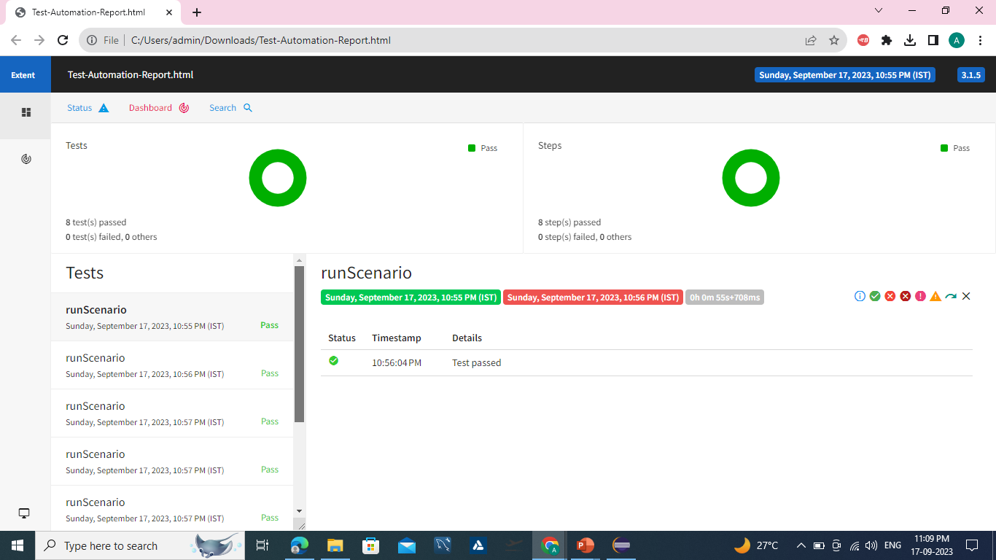
EXTENT REPORTS

Slide 30
CONCLUSION
The Project was running successfully in eclipse and generated the extent reports.
All the test scenarios are verified successfully.
Here, We merged all the test scenarios in one Github repository:
https://github.com/SatyaRanjan07/RLL-Project

Slide 31


